Slide 1
Symmetric Key Basics Block or Stream? Secret Key Methods Salting AES KDF + Key Entropy GCM Prof Bill Buchanan OBE, Pavlos Papadopoulos http://asecuritysite.com/encryption

Slide 2

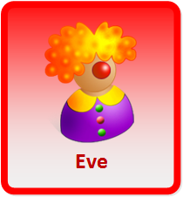


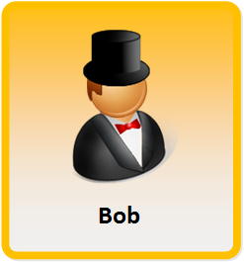
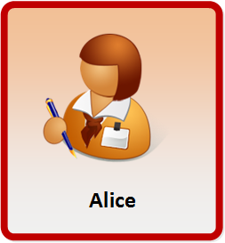
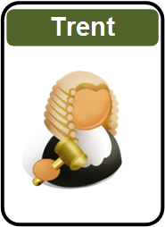

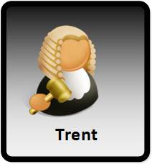
Encryption
Encryption works great, until it doesn't.
Encryption works great, as long as no one makes a mistake.
Encryption works great, unless something goes wrong.
Encryption works great, as long as everything works right.

Slide 3
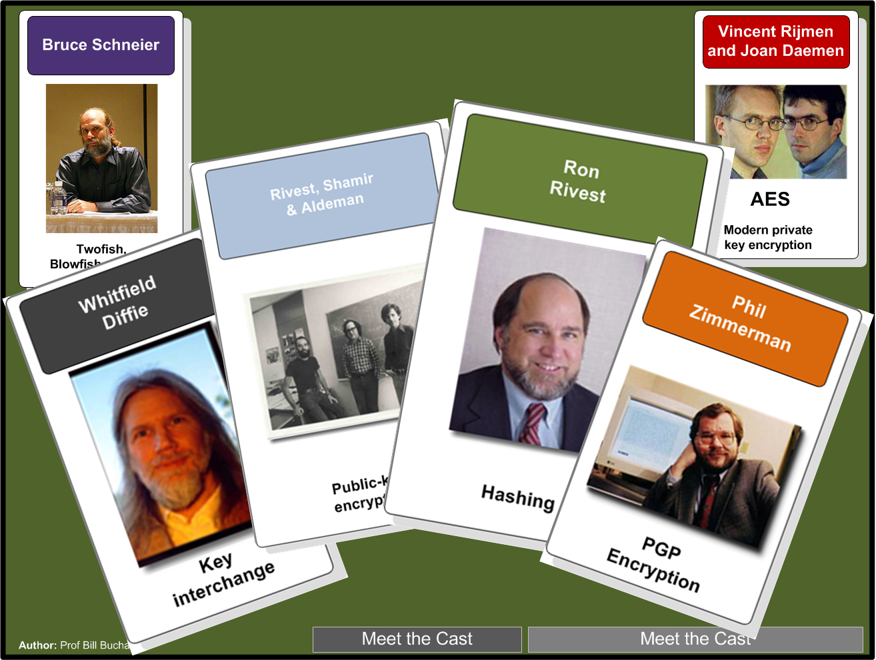

Slide 4
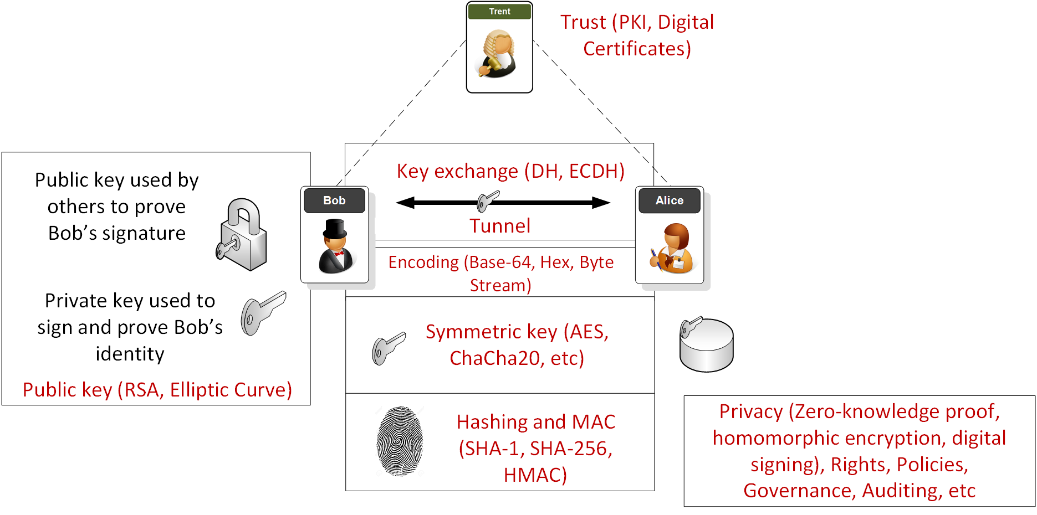
Overview

Slide 5
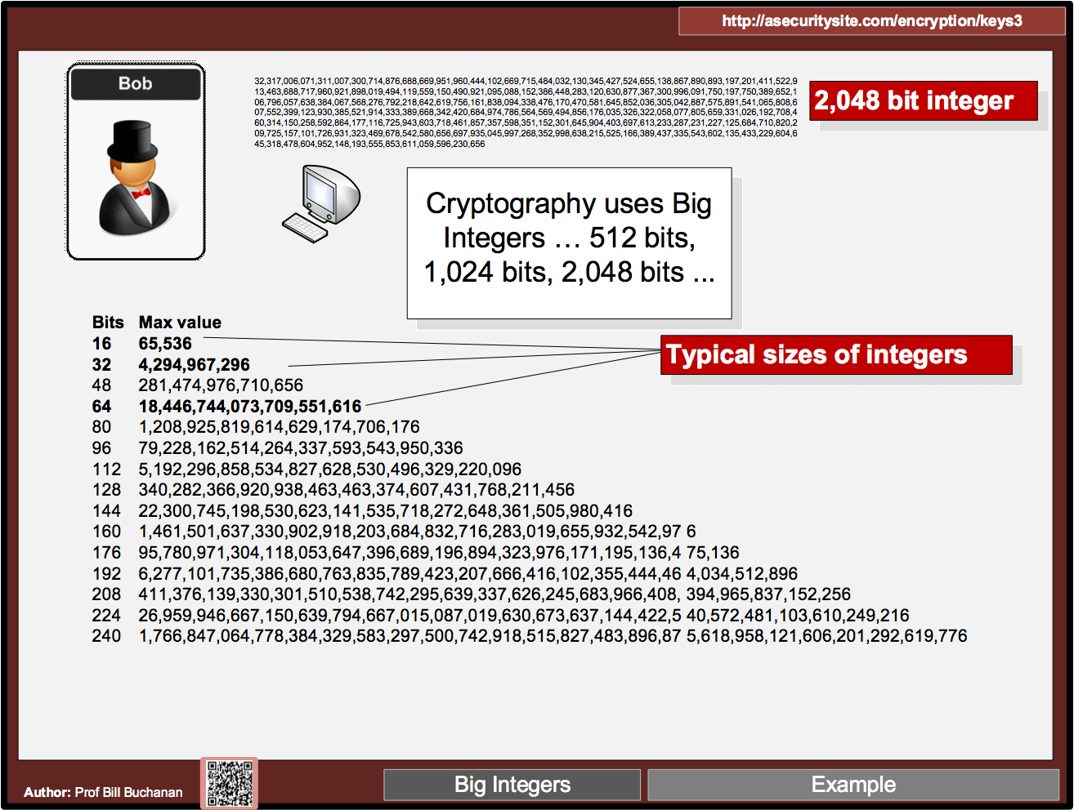

Slide 6
Puzzle
For a 128-bit key and brute force, how long would it take to crack a single key for 10 billion tries per second?
10 days?
100 days?
1 year?
10 years?
100 years?

Slide 7
For a 128-bit key and brute force, how long would it take to crack a single key for 10 billion tries per second?
529 million million million years - Boil every ocean on planet, 16,384 times
Article

Slide 8
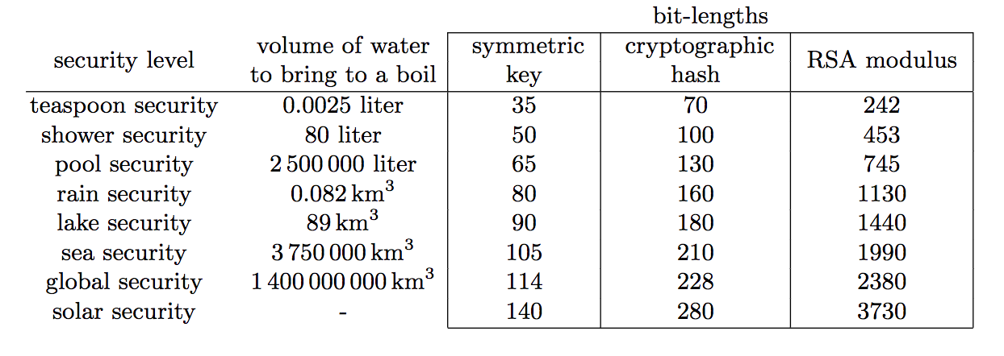
Boiling the planet
Article

Slide 9
Secret Key Basics Block or Stream? Secret Key Methods Salting AES KDF + Key Entropy GCM Prof Bill Buchanan OBE, Pavlos Papadopoulos http://asecuritysite.com/encryption

Slide 10
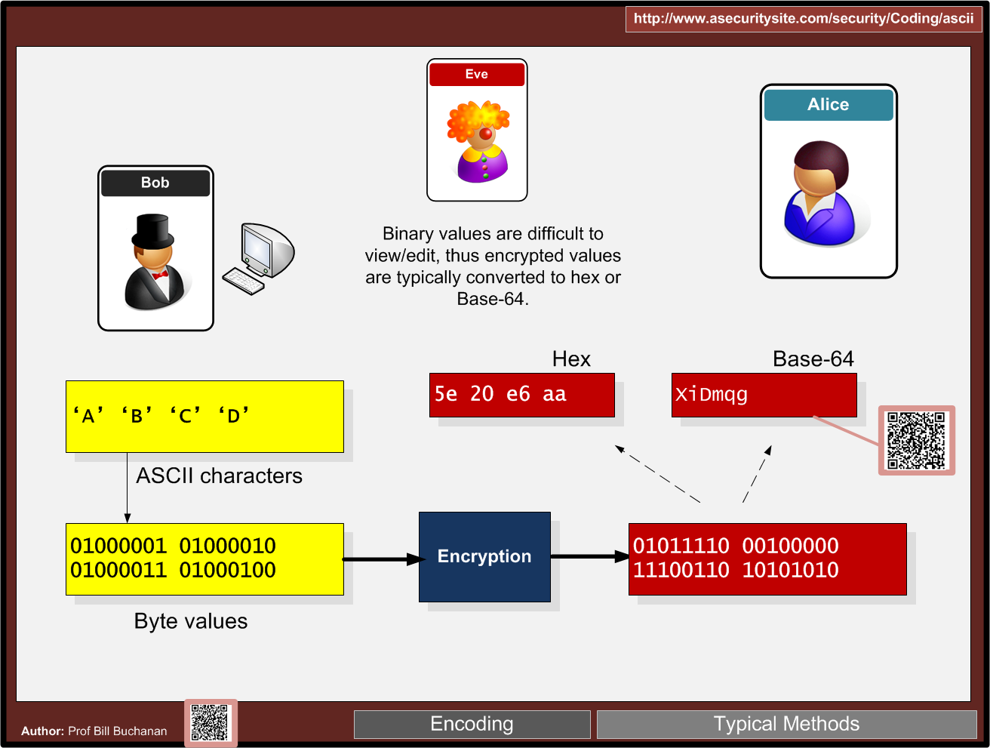

Slide 11
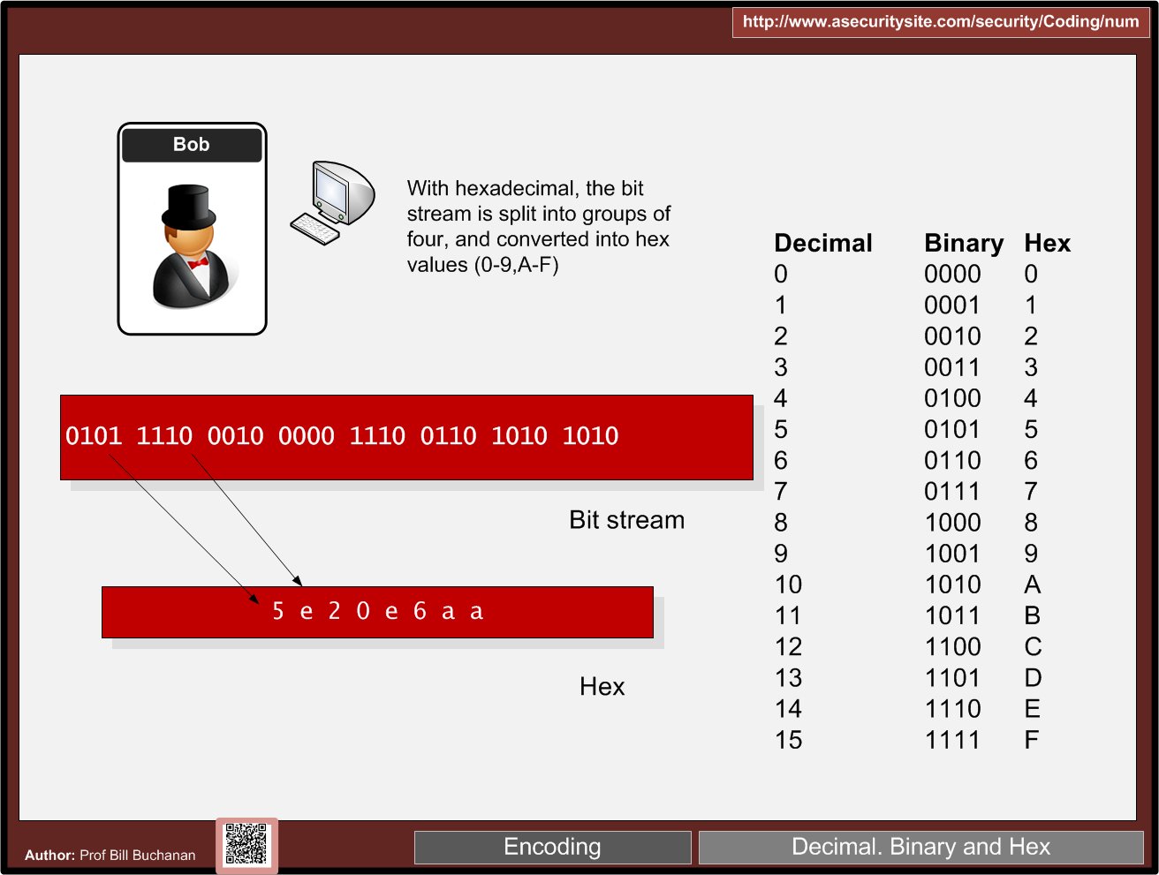

Slide 12
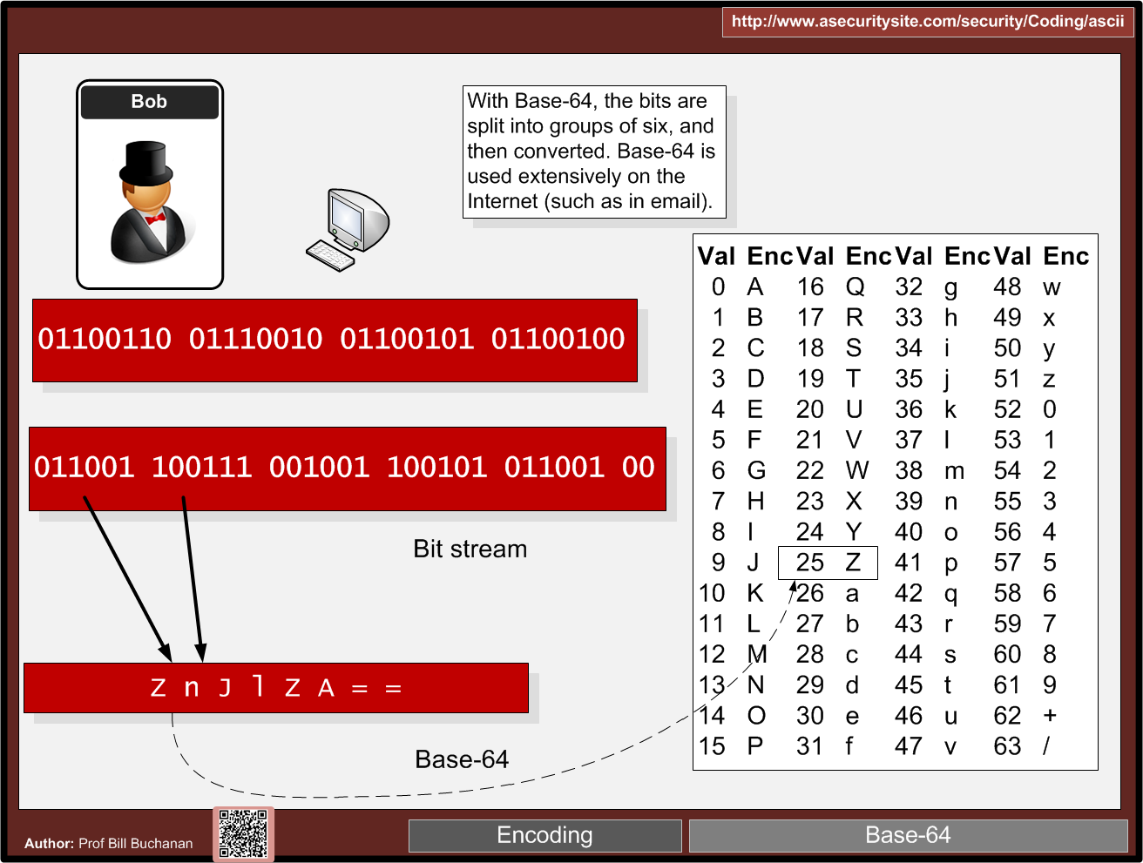

Slide 13
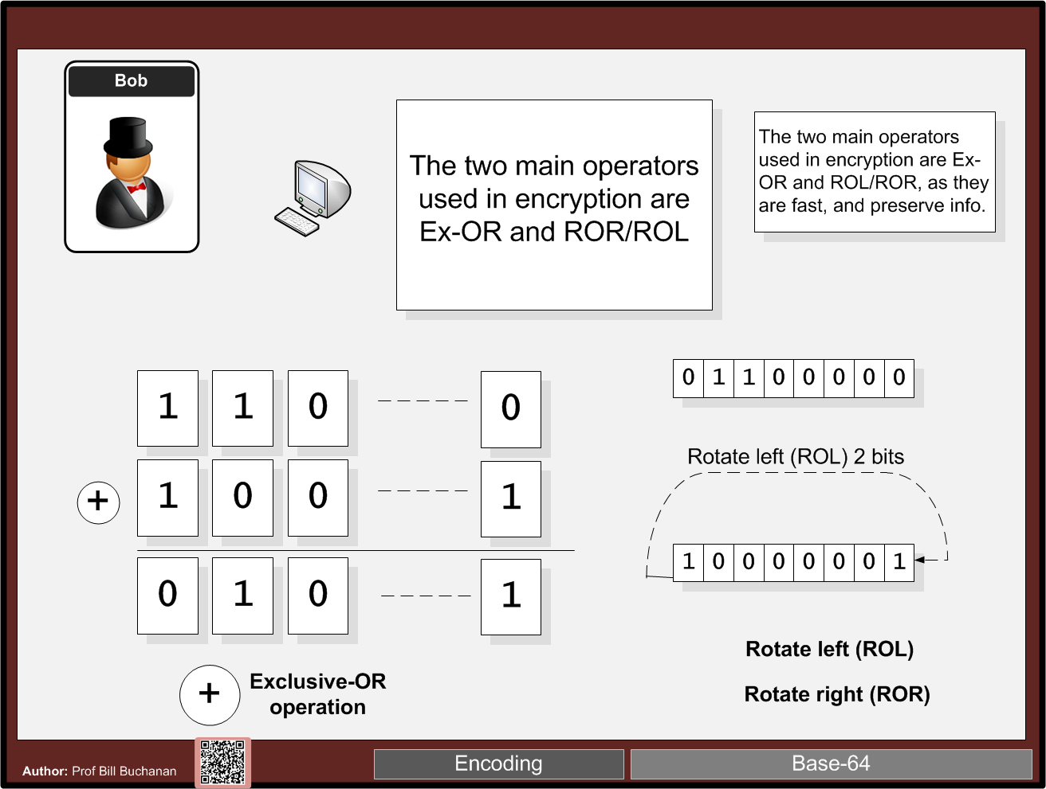

Slide 14
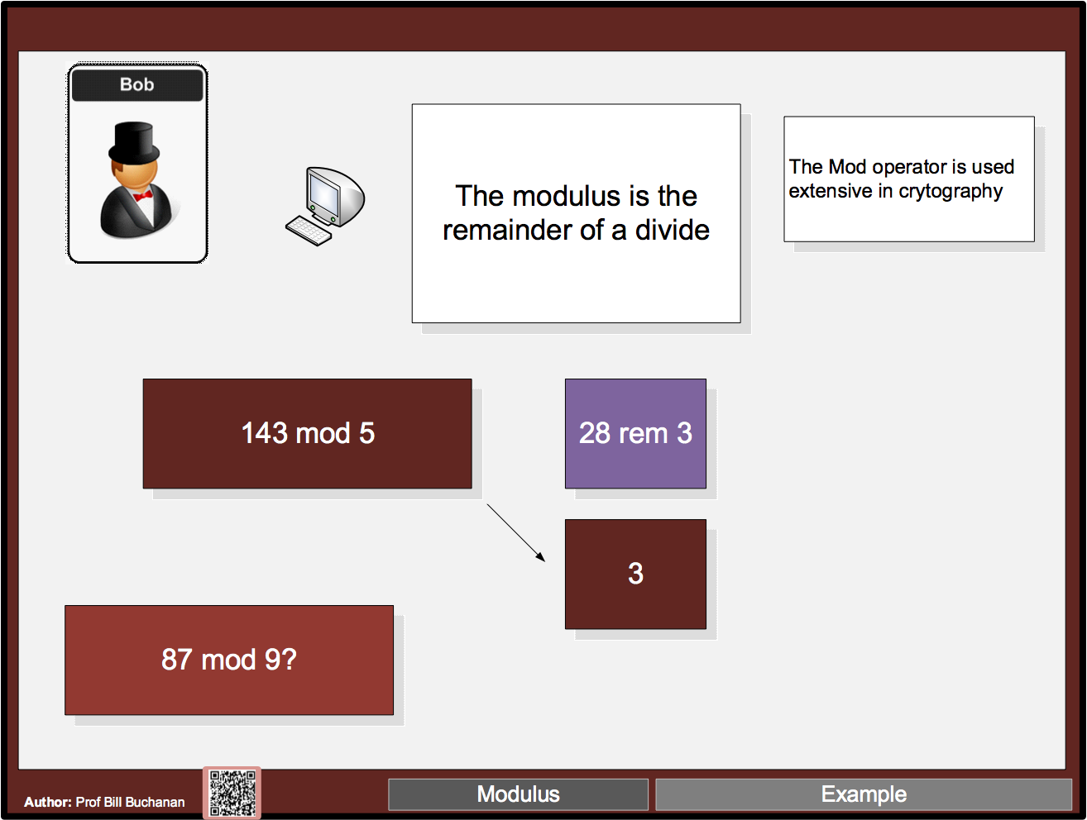

Slide 15
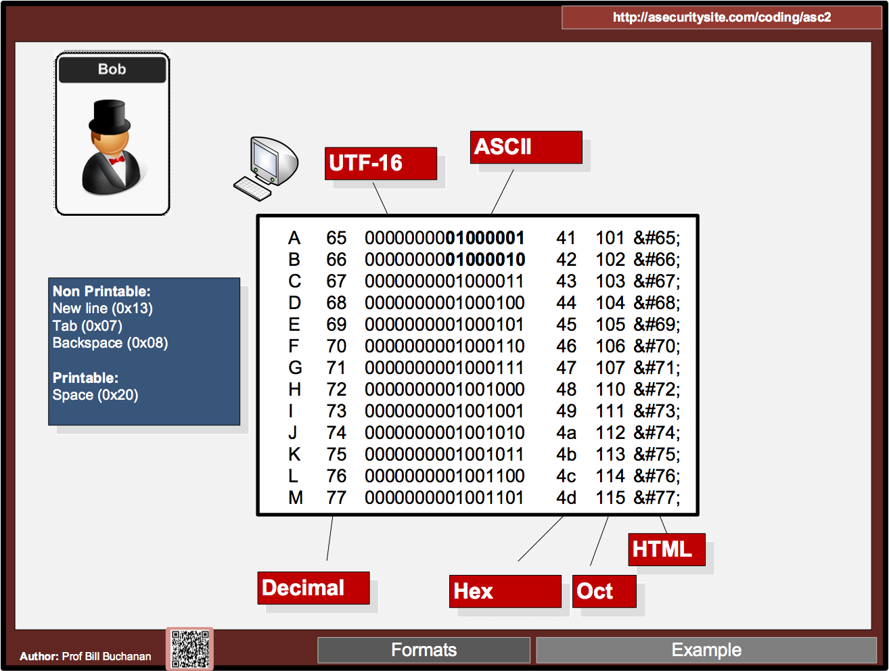

Slide 16
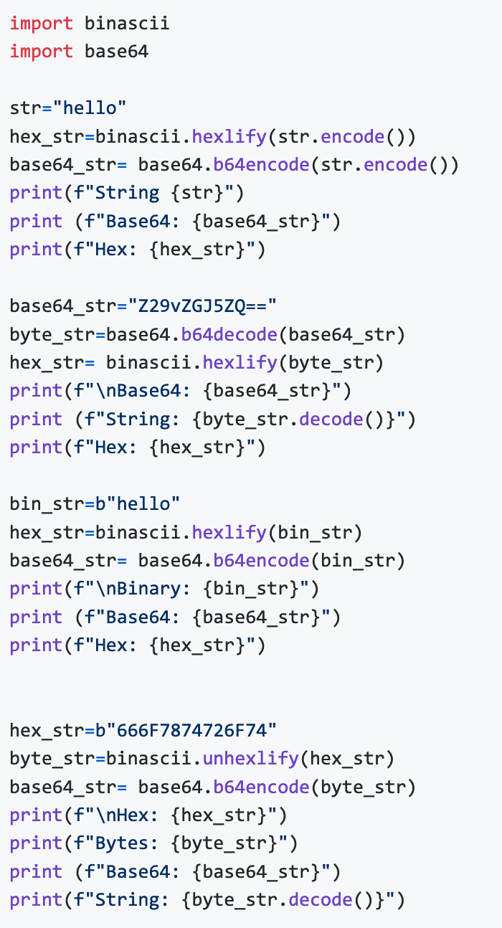

Slide 17
Secret Key Basics Block or Stream? Secret Key Methods Salting AES KDF + Key Entropy GCM

Slide 19
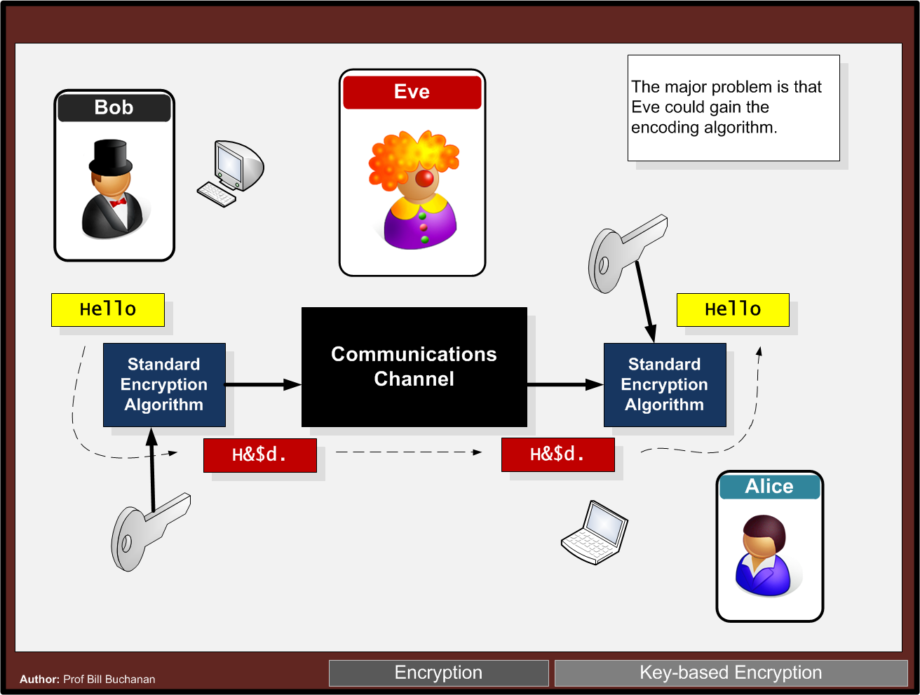

Slide 20
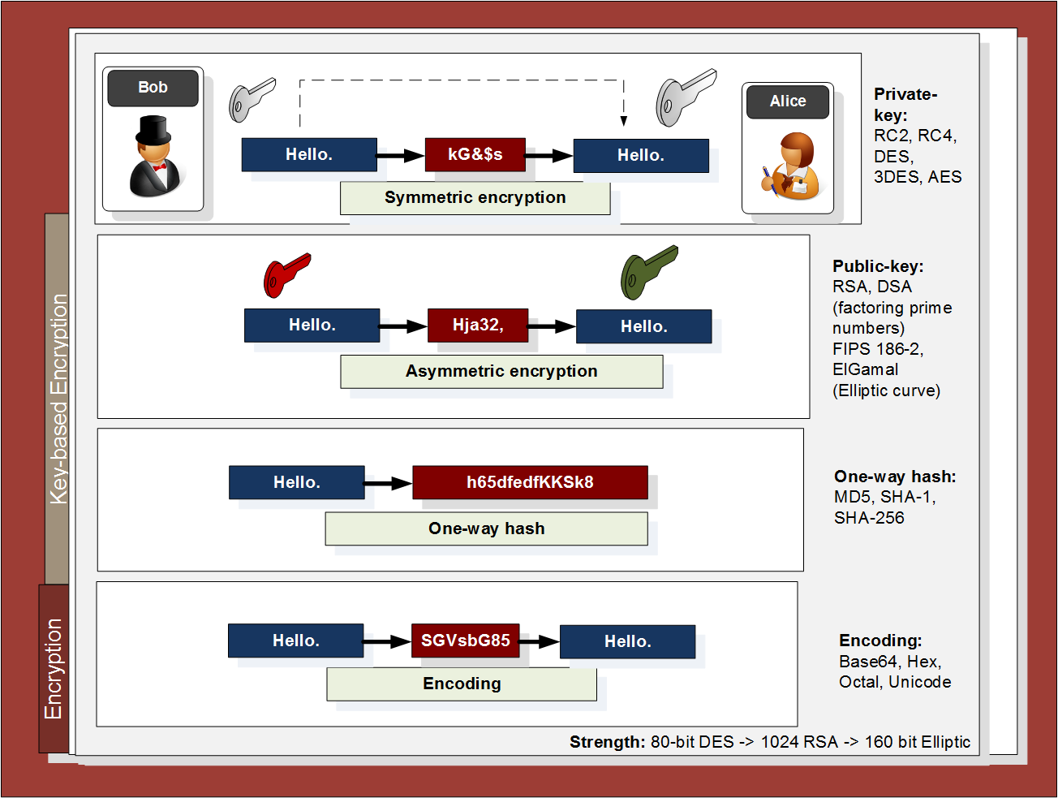

Slide 21
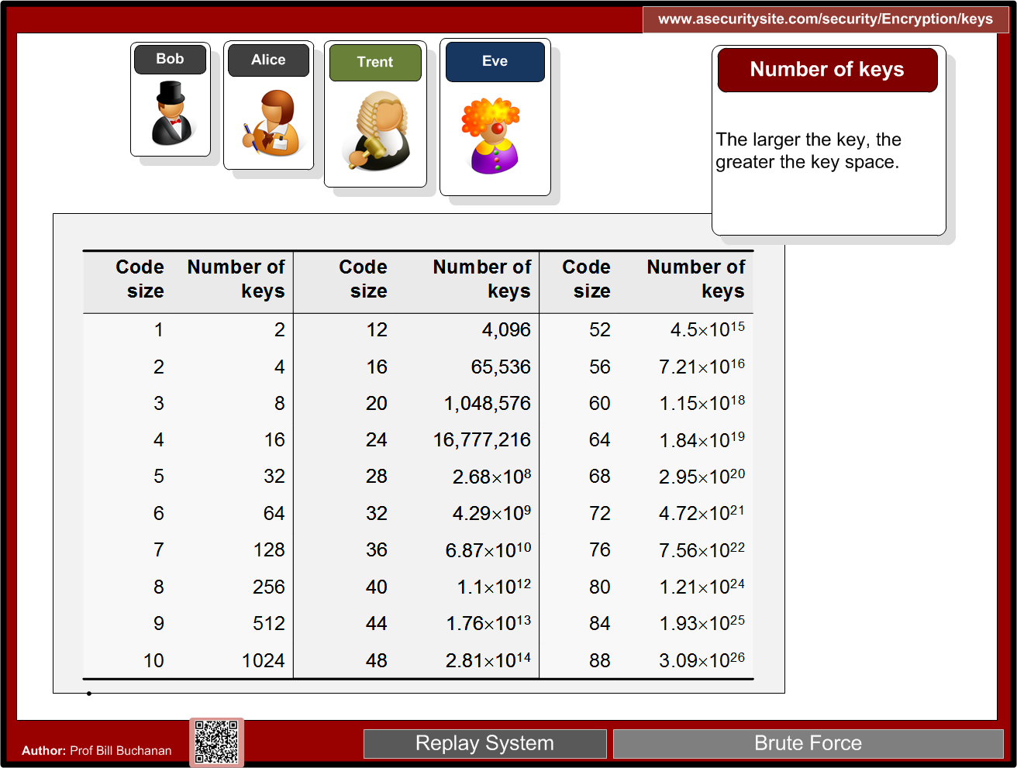

Slide 22
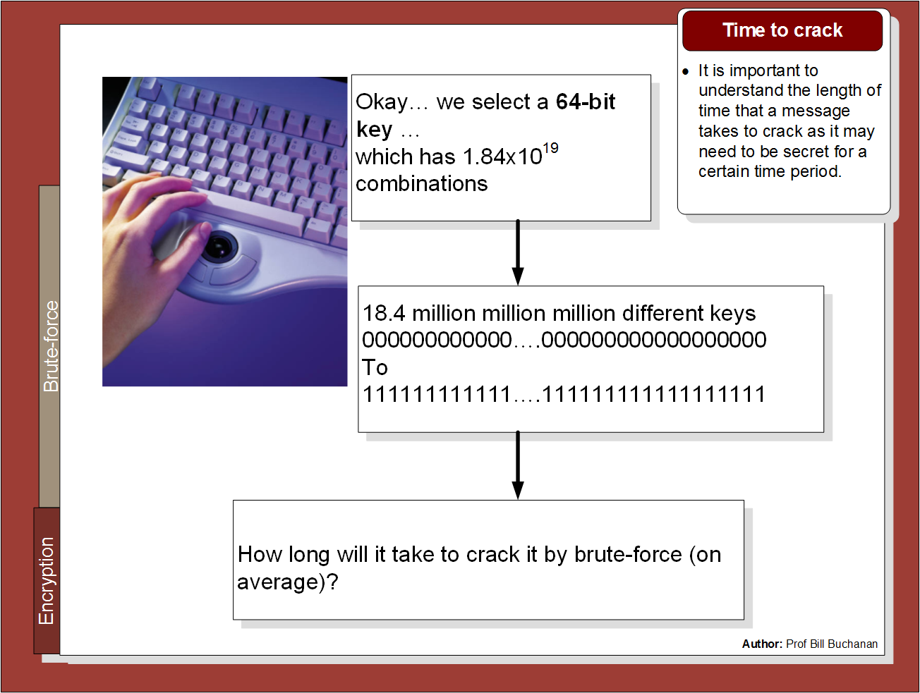

Slide 23
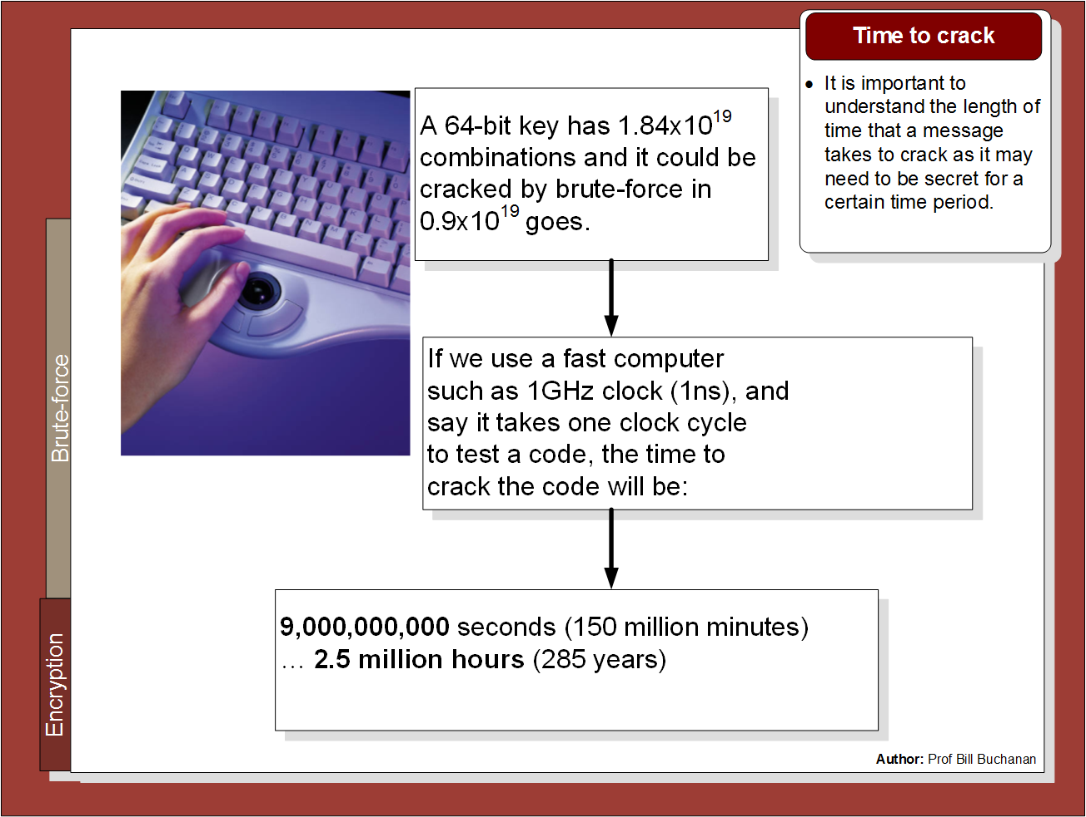

Slide 24
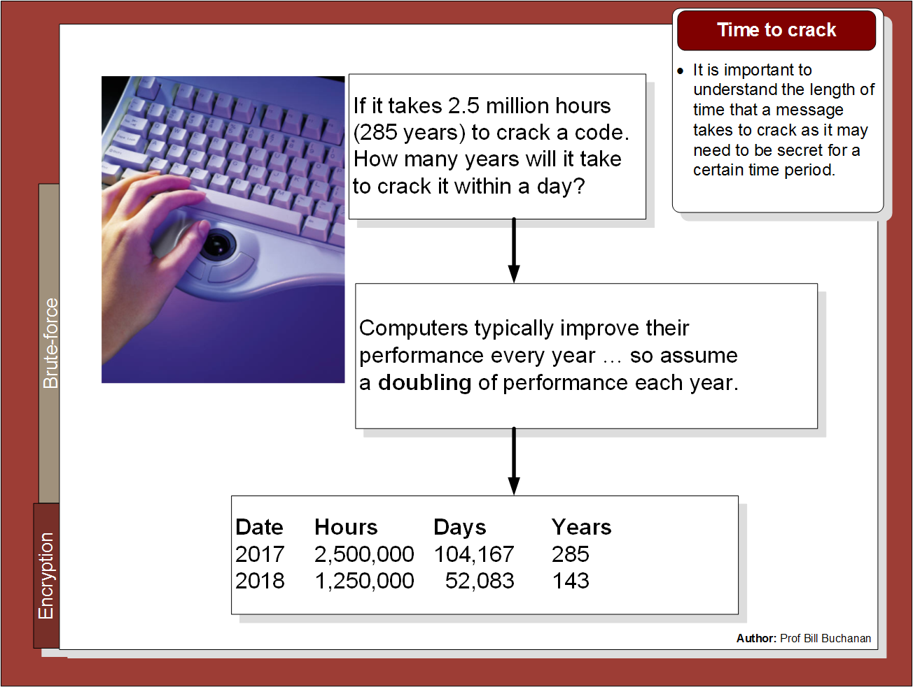

Slide 25
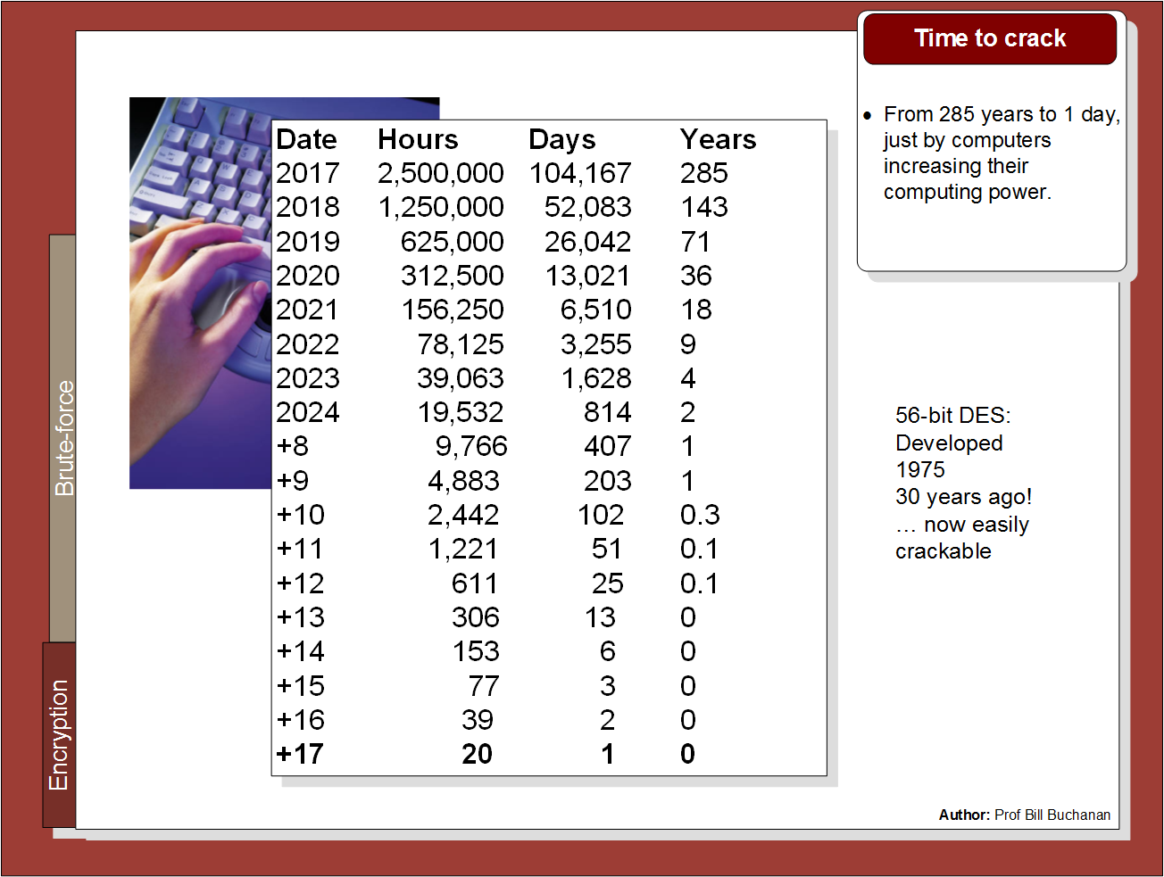

Slide 26
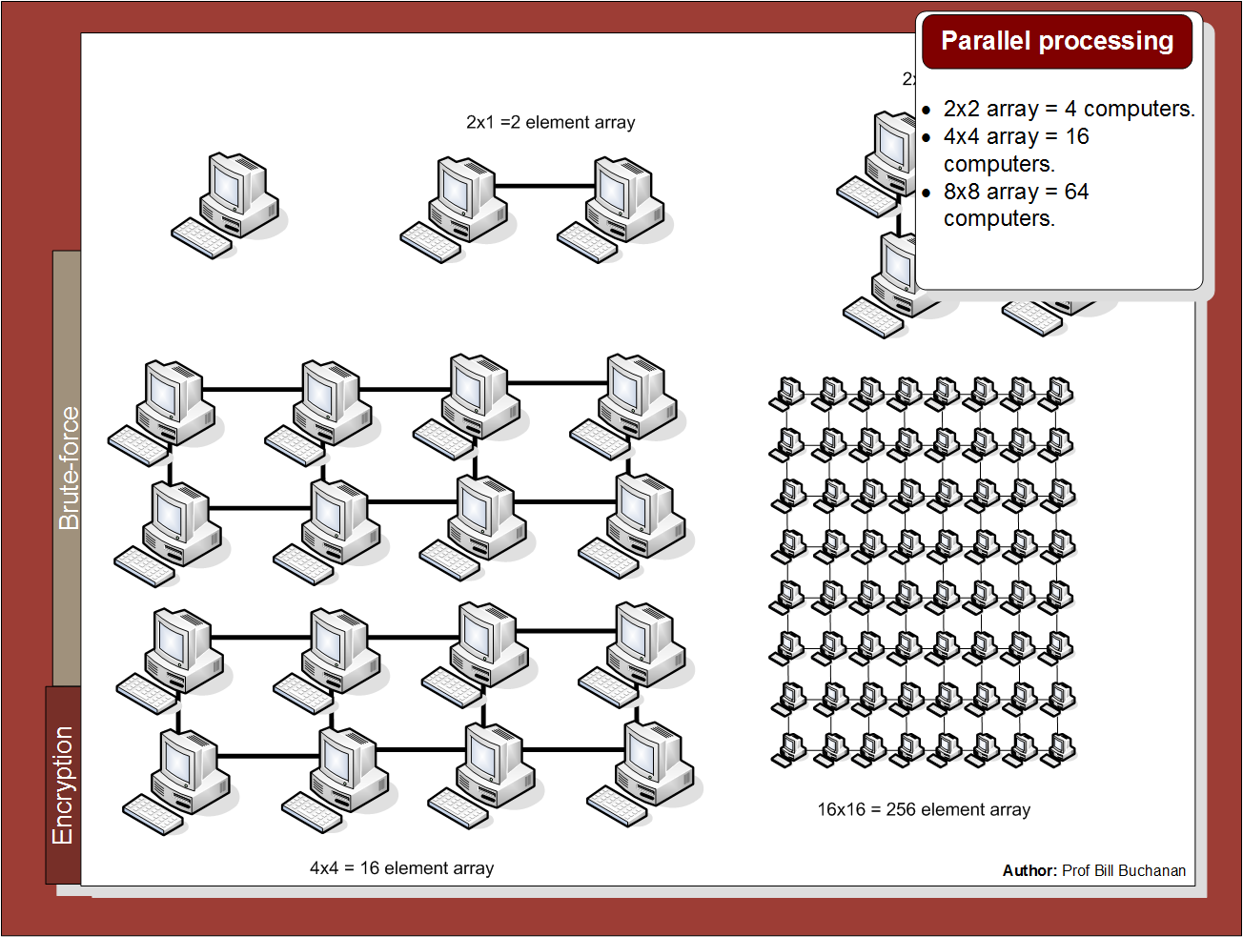

Slide 27
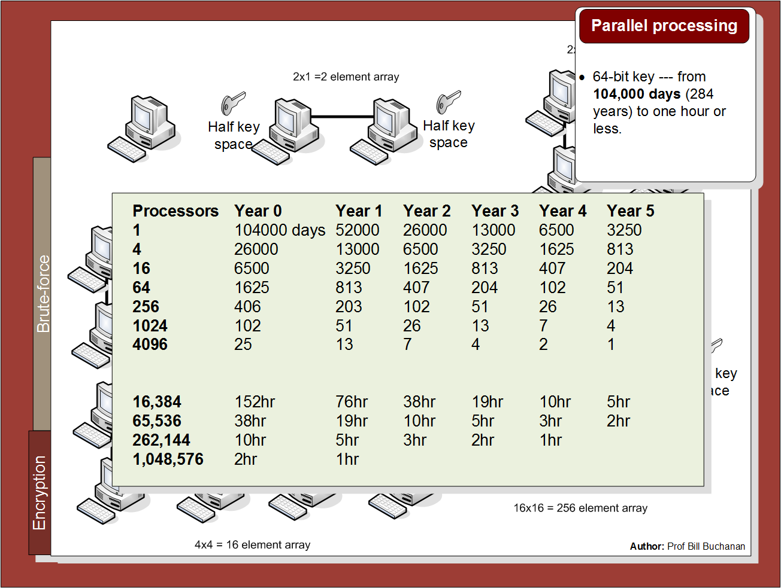

Slide 28

Chapter 2: Secret Key Basics Block or Stream? Secret Key Methods Salting AES KDF + Key Entropy GCM Prof Bill Buchanan OBE http://asecuritysite.com/crypto02 http://asecuritysite.com/encryption

Slide 29
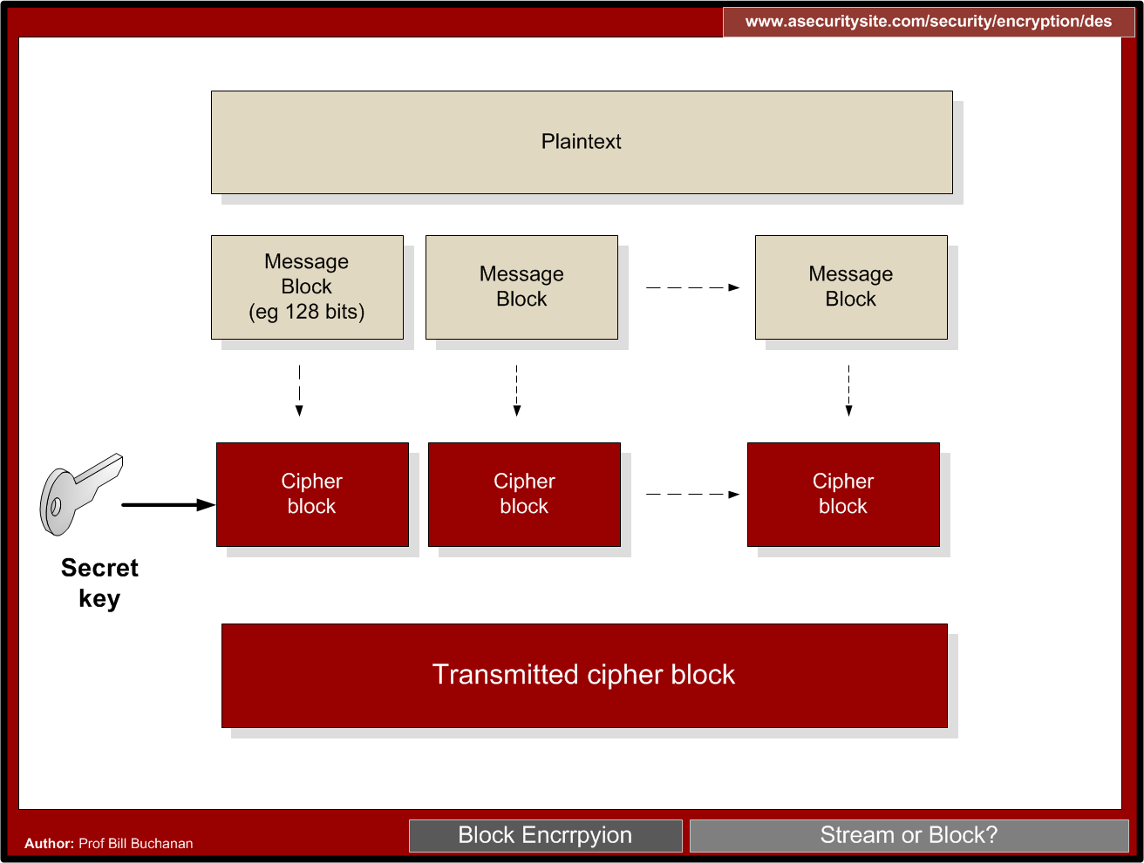

Slide 30
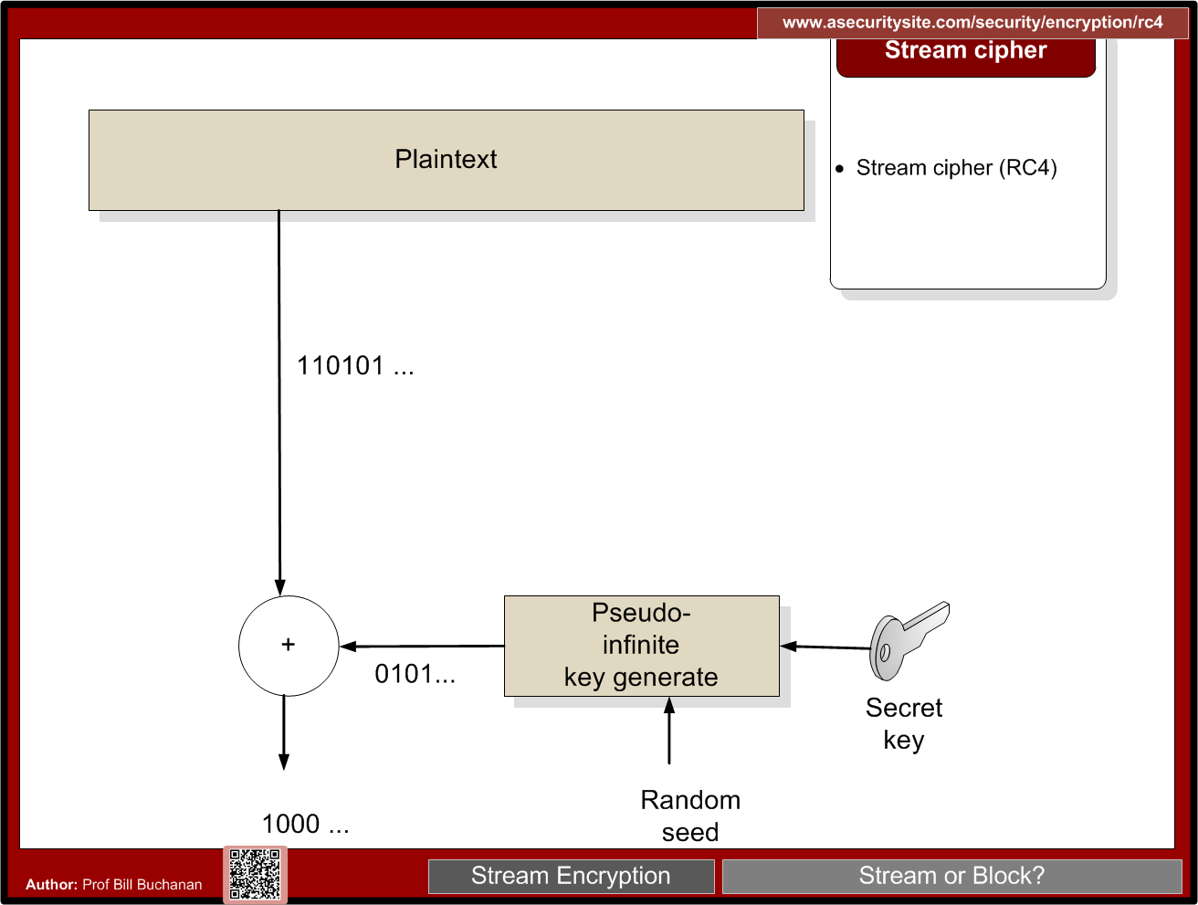

Slide 32
Padding
CMS (Cryptographic Message Syntax). This pads with the same value as the number of padding bytes. Defined in RFC 5652, PKCS#5, PKCS#7 and RFC 1423 PEM. Link
Bits. This pads with 0x80 (10000000) followed by zero (null) bytes. Defined in ANSI X.923 and ISO/IEC 9797-1.
ZeroLength. This pads with zeros except for the last byte which is equal to the number (length) of padding bytes.
Null. This pads will NULL bytes. This is only used with ASCII text.
Space. This pads with spaces. This is only used with ASCII text.
Random. This pads with random bytes with the last byte defined by the number of padding bytes.

Slide 33
Padding
After padding (CMS): 68656c6c6f0b0b0b0b0b0b0b0b0b0b0b Cipher (ECB): 0a7ec77951291795bac6690c9e7f4c0d
After padding (Bit): 68656c6c6f8000000000000000000000 Cipher (ECB): 731abffc2e3b2c2b5caa9ca2339344f9
After padding (ZeroLen): 68656c6c6f000000000000000000000a Cipher (ECB): d28e2f7e8e44e068732b292bde444245
After padding (Null): 68656c6c6f0000000000000000000000 Cipher (ECB): 444797422460453d95856eb2a1520ece
After padding (Space): 68656c6c6f0000000000000000000000 Cipher (ECB): 444797422460453d95856eb2a1520ece
After padding (Random): 68656c6c6ffc6ecfd884a38798d62a0a Cipher (ECB): c2c88b4364d2c2dc6f2cac9ab73c995d

Slide 34
Symmetric Key Basics Block or Stream? Secret Key Methods Salting AES KDF + Key Entropy GCM

Slide 36
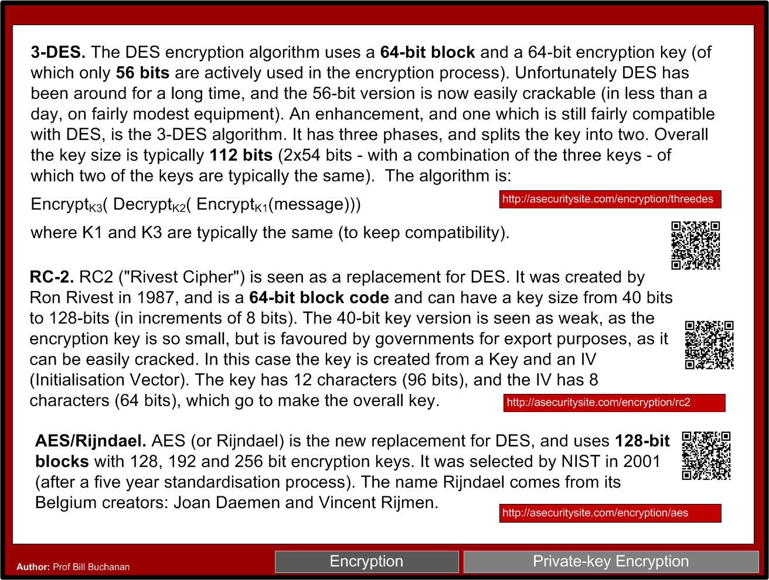

Slide 37


Slide 38
Symmetric Key Basics Block or Stream? Secret Key Methods Salting AES KDF + Key Entropy GCM

Slide 39
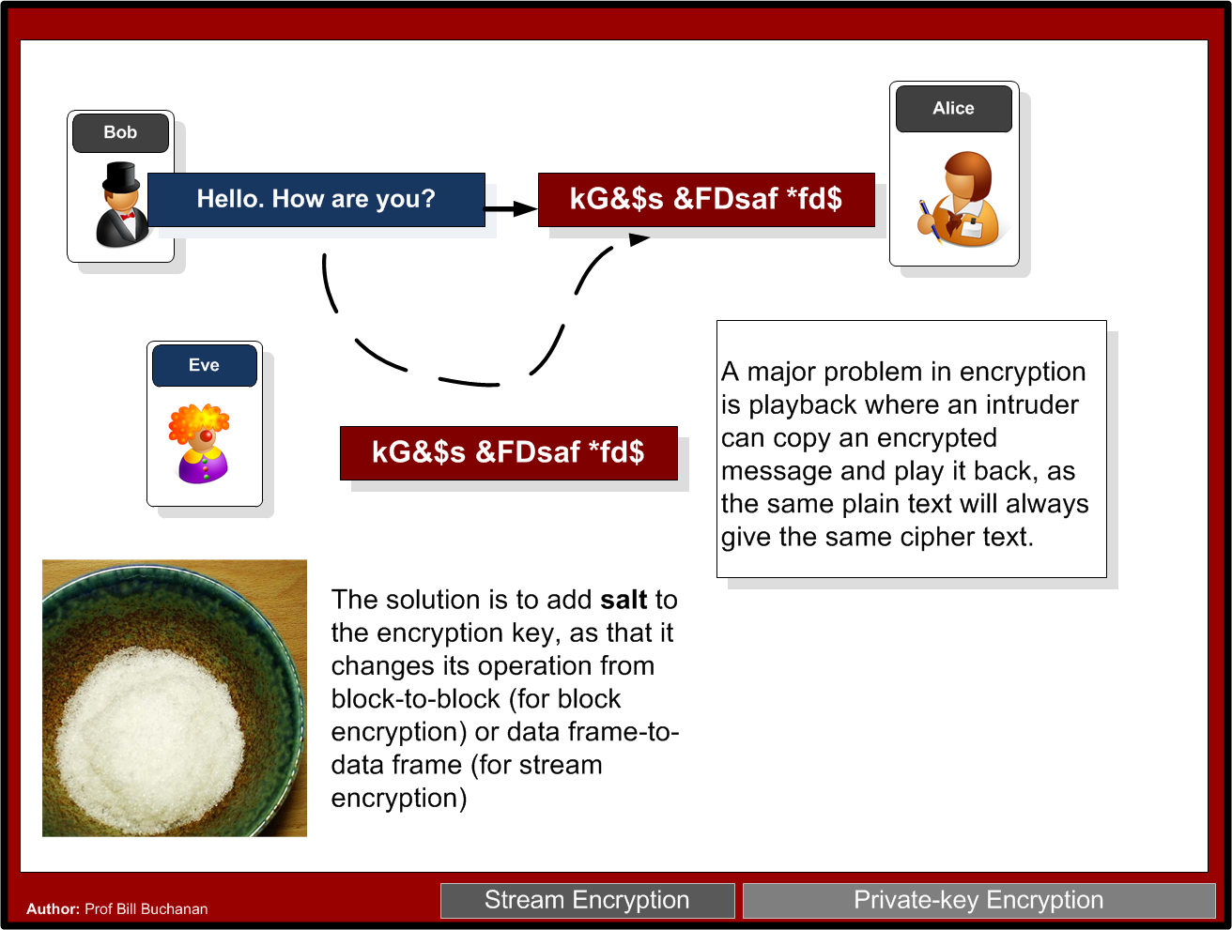

Slide 40
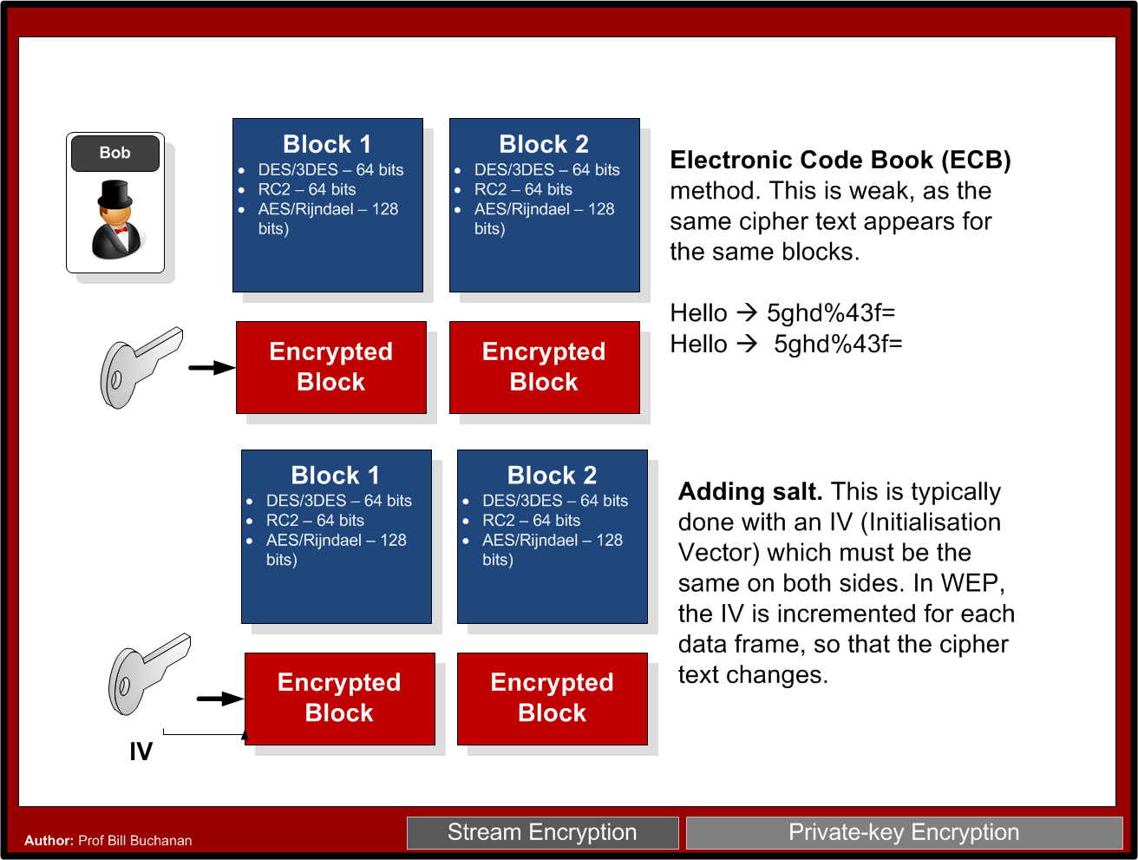

Slide 41
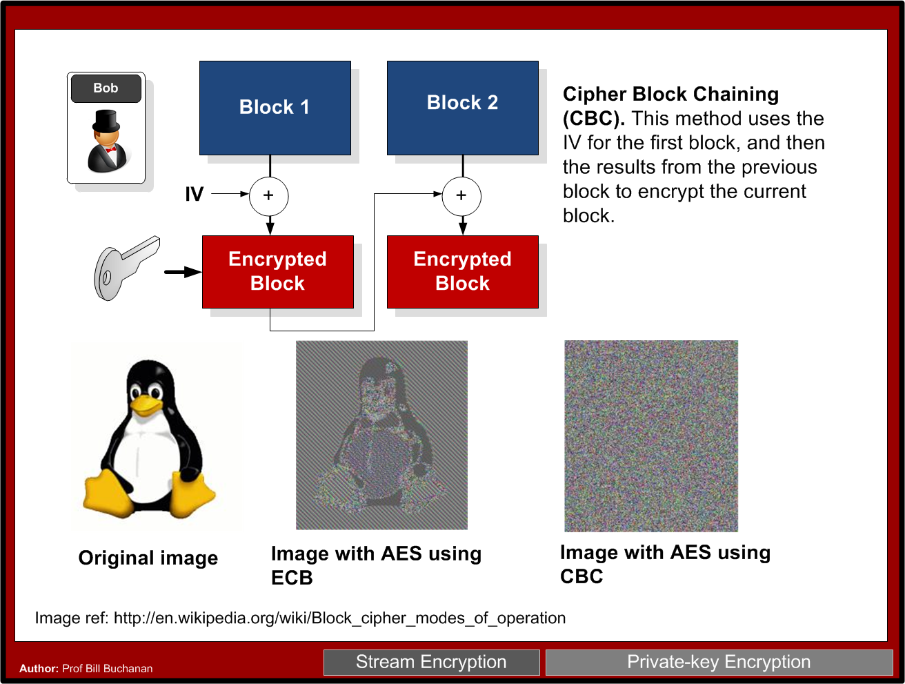

Slide 43
Symmetric Key Basics Block or Stream? Secret Key Methods Salting AES KDF + Key Entropy GCM

Slide 44
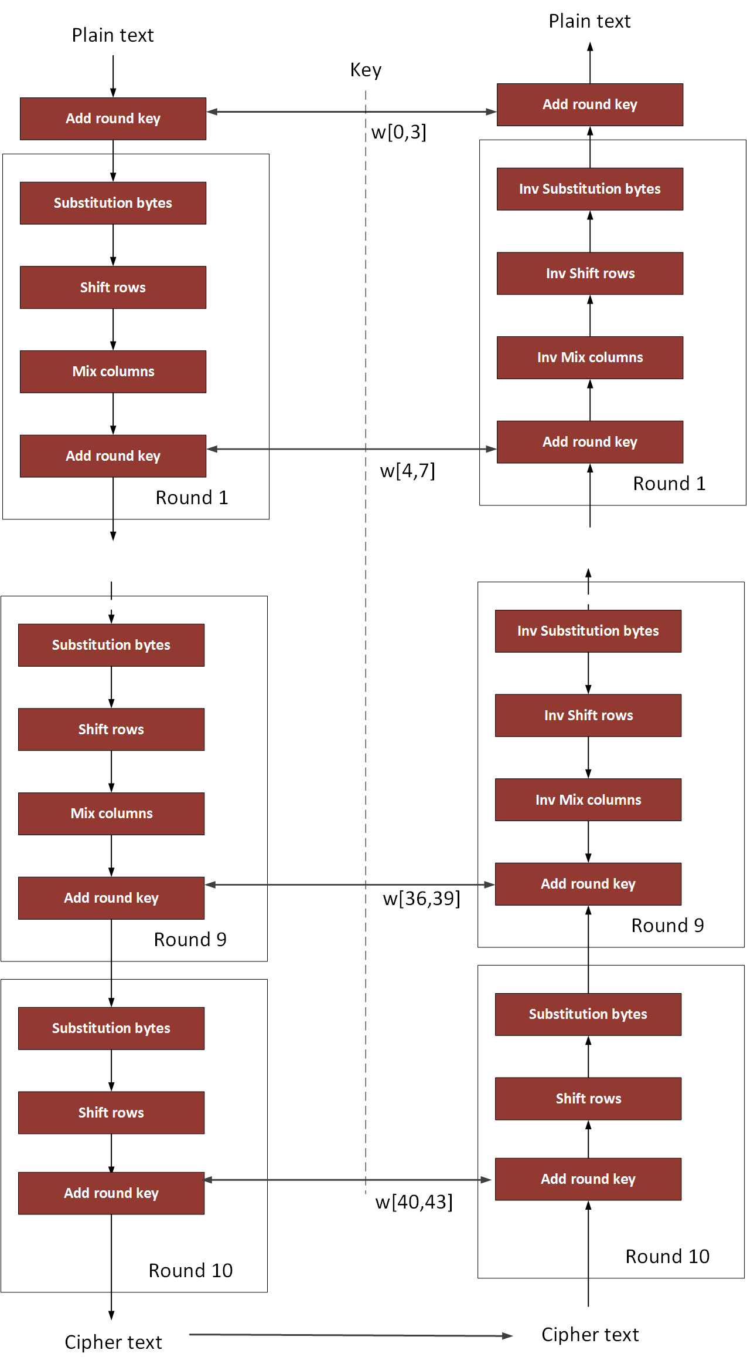
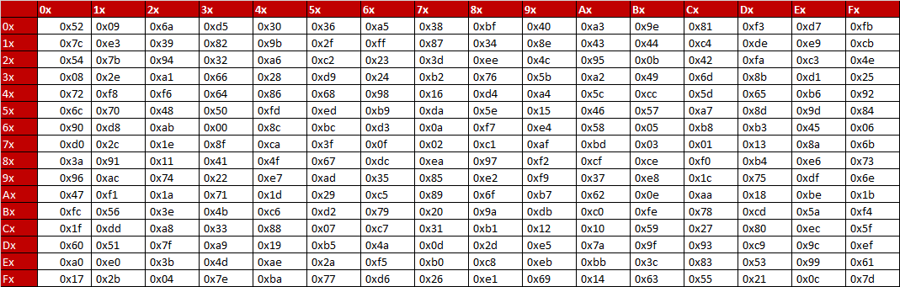
AES

Slide 45
3-DES

Slide 46
Symmetric Key Basics Block or Stream? Secret Key Methods Salting AES KDF + Key Entropy GCM

Slide 47
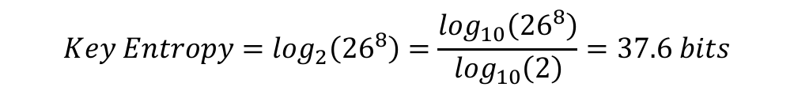
KDF and Key Entropy
Password definition | Number of possible characters | Total number of passwords | Entropy (bits)
[0-9] | 10 | 100,000,000 | 26.6
[a-z] | 26 | 2.08827x10¹¹ | 37.6
[a-zA-Z] | 52 | 5.34597x10¹³ | 45.6
[a-zA-Z0-9] | 62 | 2.1834x10¹⁴ | 47.6
[a-zA-Z0-9$%!@+=] | 68 | 4.57163x10¹⁴ | 48.7

Slide 48
1: Secret Key Basics Block or Stream? Secret Key Methods Salting AES KDF + Key Entropy GCM, RC4 and ChaCha20

Slide 49
GCM
GCM converts AES into a block cipher to a stream cipher - based on CTR mode. Much faster than CBC [Link]
Integrates AEAD (Authenticated Encryption with Associated Data).

Slide 50
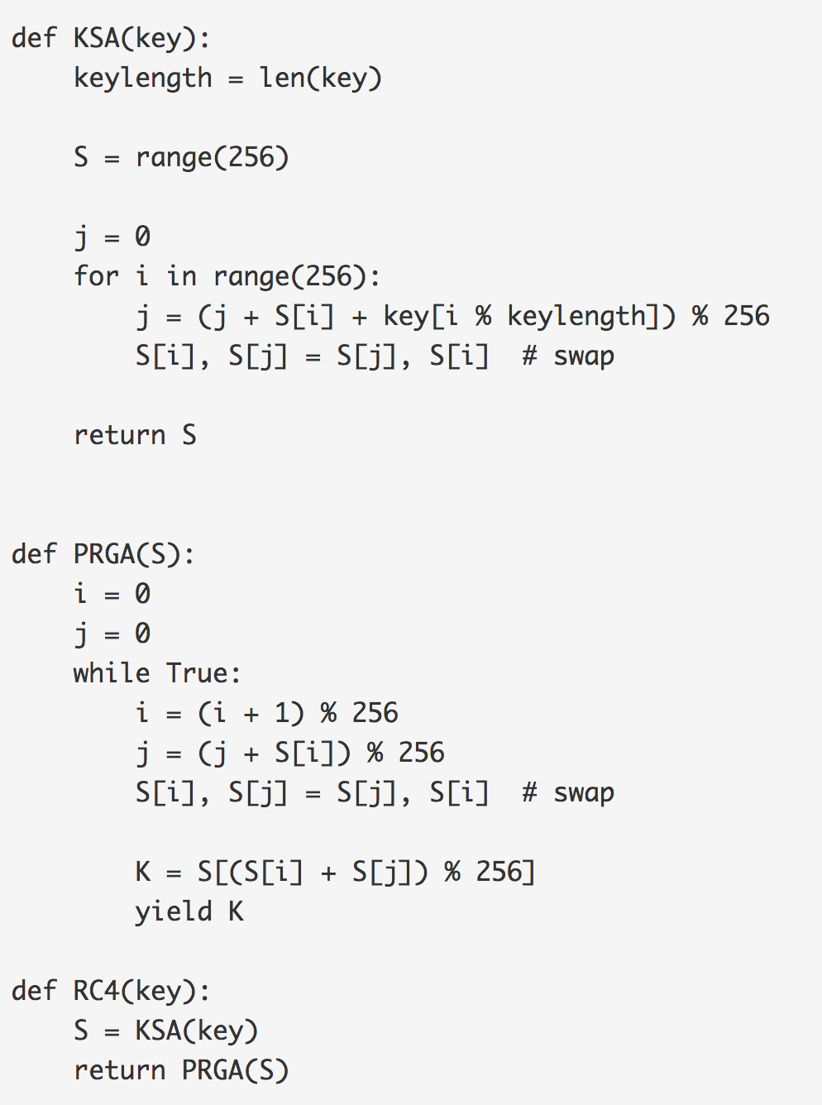
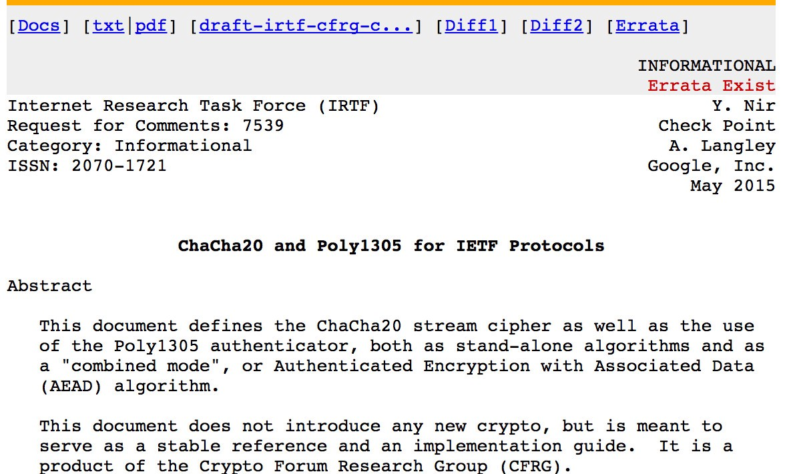
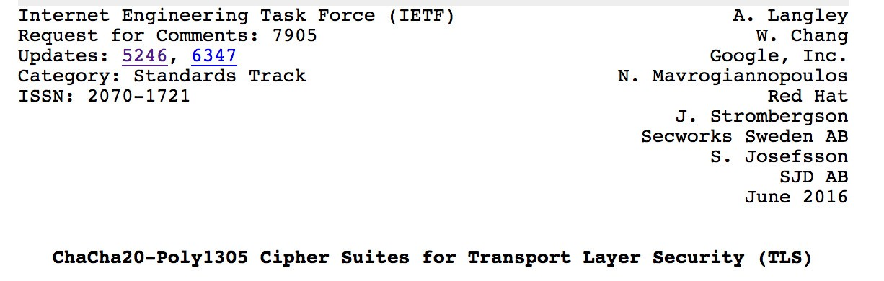
Try!
Try!

Slide 51
Symmetric Key Basics Block or Stream? Secret Key Methods Salting AES KDF + Key Entropy GCM

